Slide 1
How to fill out the Parent’s Financial Statement
Section 3 – Deductions

Slide 2
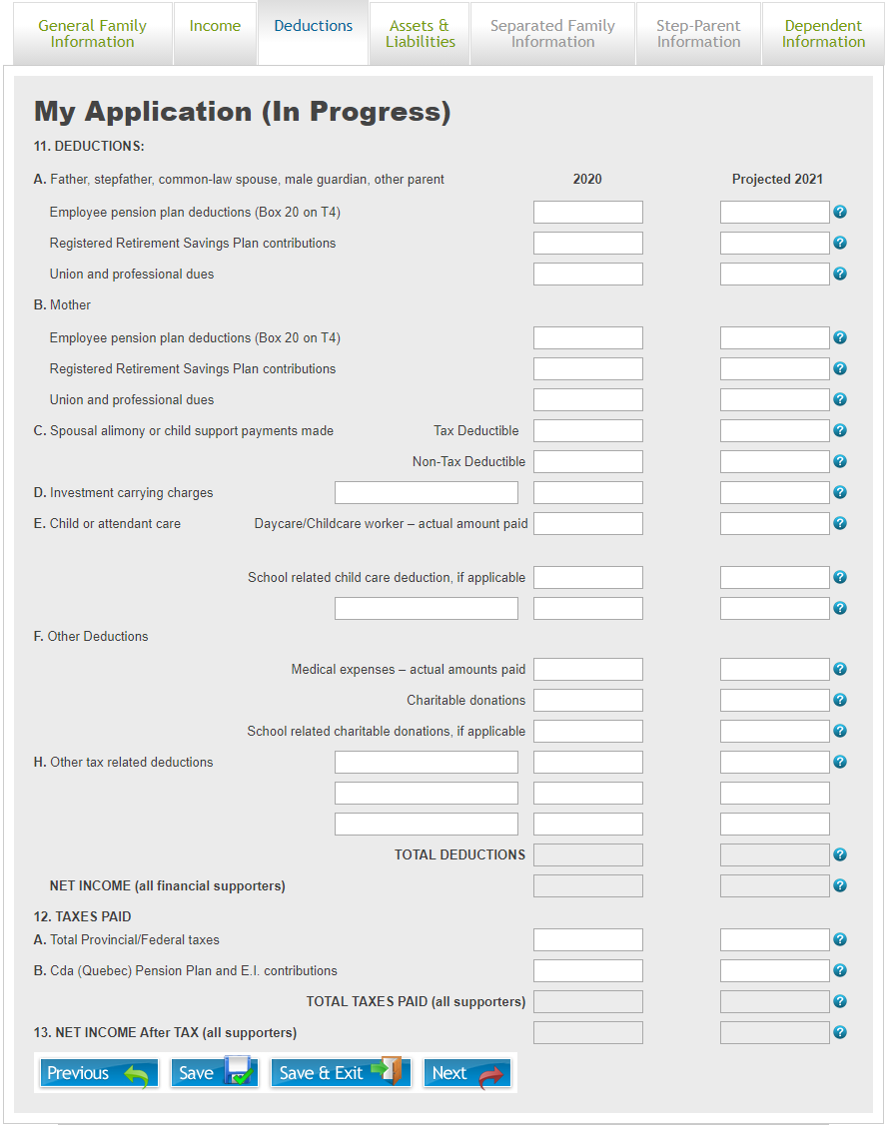
Deductions
On the “Deductions” tab of the application, information will be collected related to deductions both taxable and non-taxable that can be deducted from income.

Slide 3
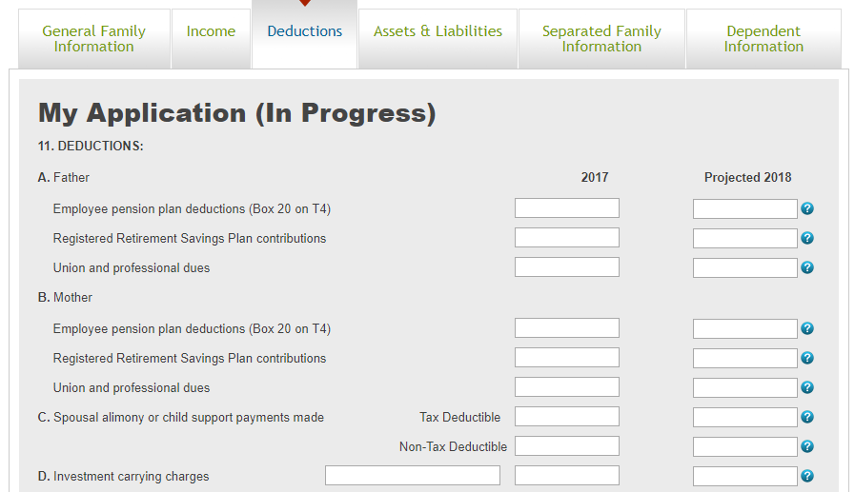
Deductions - 1
Section 11 – A/B
  Enter any income that is deducted for employee pension plan contributions. This amount will be noted in Box 20 on your T4. This does not include CPP/QPP deductions
  Enter any RRSP contributions that you have made or plan to make
  Enter any union and/or professional dues that you pay
Section 11 – C
  Enter any spousal alimony or child support payments that you made and/or are required to pay. Please distinguish between tax deductible and non-tax deductible payments
Section 11 – D
  In the leftmost box, provide details around the investment(s) from which you are writing off the carrying charges.
  Enter the dollar amount of investment carrying charges for the relevant year(s) that can be written off against your taxes

Slide 4
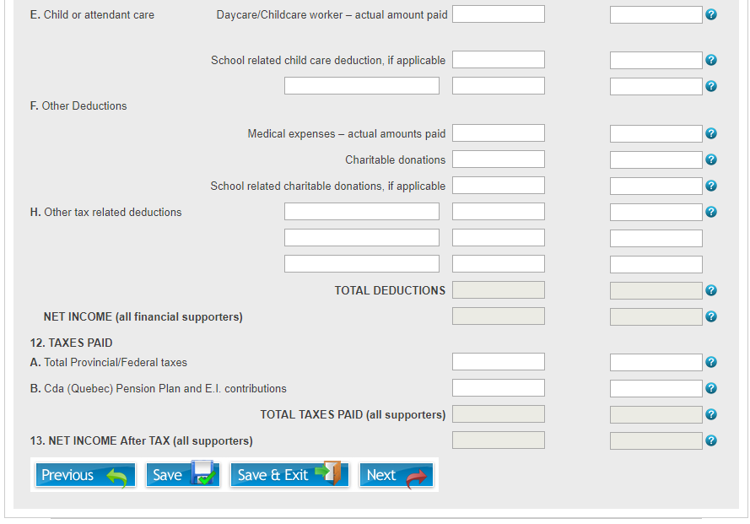
Deductions - 2
Section 11 – E
  Enter the total costs you pay for daycare or a childcare worker.
    NOTE: This may be different from the amount you are able to deduct on your tax return for these costs
  Depending on the amount entered for daycare/childcare expenses, a box may open allowing you to provide some additional details
  Enter any school related child care that is part of school tuition for which a tax receipt is received
  If you have childcare expenses not covered by the two categories above, enter details in the leftmost box and the amounts in the boxes for the relevant year(s)
Section 11 – F
  Enter any amounts you pay for: Medical expenses, Charitable donations and School related charitable donations for which you receive a tax receipt
  Depending on the amount entered for Medical expenses, a box may open allowing you to provide some additional details
Section 11 – H
  Please enter details and amounts for any other tax related deductions that were not covered by the above categories (i.e. the Primary Caregiver Tax Credit)
Section 12 – A/B
  Please enter the amount of Provincial/Federal taxes paid or expected to be paid as well as the amount of CPP, QPP and/or EI contributions that were made or expected.
  If this amount for the projected year is unknown, this box can be left blank and Apple Financial Services will calculate an estimate of your taxes, CPP, QPP, and/or EI for the projected year.

